Slide 1

Gitting Started
DSBA 6190-U90 | Colby T. Ford, Ph.D.

Slide 2

What is Git?
Version Control
Which changes were made?
Who made the changes?
When were the changes made?
Why were changes needed?
Terminology
Code is stored in a repository
If you want to use someone else’s code and make changes, you can fork it. Then, submit a pull request to try and merge the changes back in
Your team can work on separate branches of the same repository
Repositories are usually initialized with a README.md, a .gitignore, and a license.
https://www.youtube.com/watch?v=w3jLJU7DT5E

Slide 3
Commands
https://guides.github.com/introduction/git-handbook/
git init
git clone
git pull
git push
Initializes a new Git repository and begins tracking an existing directory locally
Creates a local copy of a project that already exists remotely
Updates the local line of development with updates from its remote counterpart
Updates the remote repository with any commits made locally to a branch.
git commit
Saves the snapshot to the project history and completes the change-tracking process
git fetch
Looks at the remote repo and sees what new changes can be pulled locally
git branch
Shows the branches being worked on locally.
git merge
Merges lines of development together
git status
Shows the status of changes as untracked, modified, or staged

Slide 4


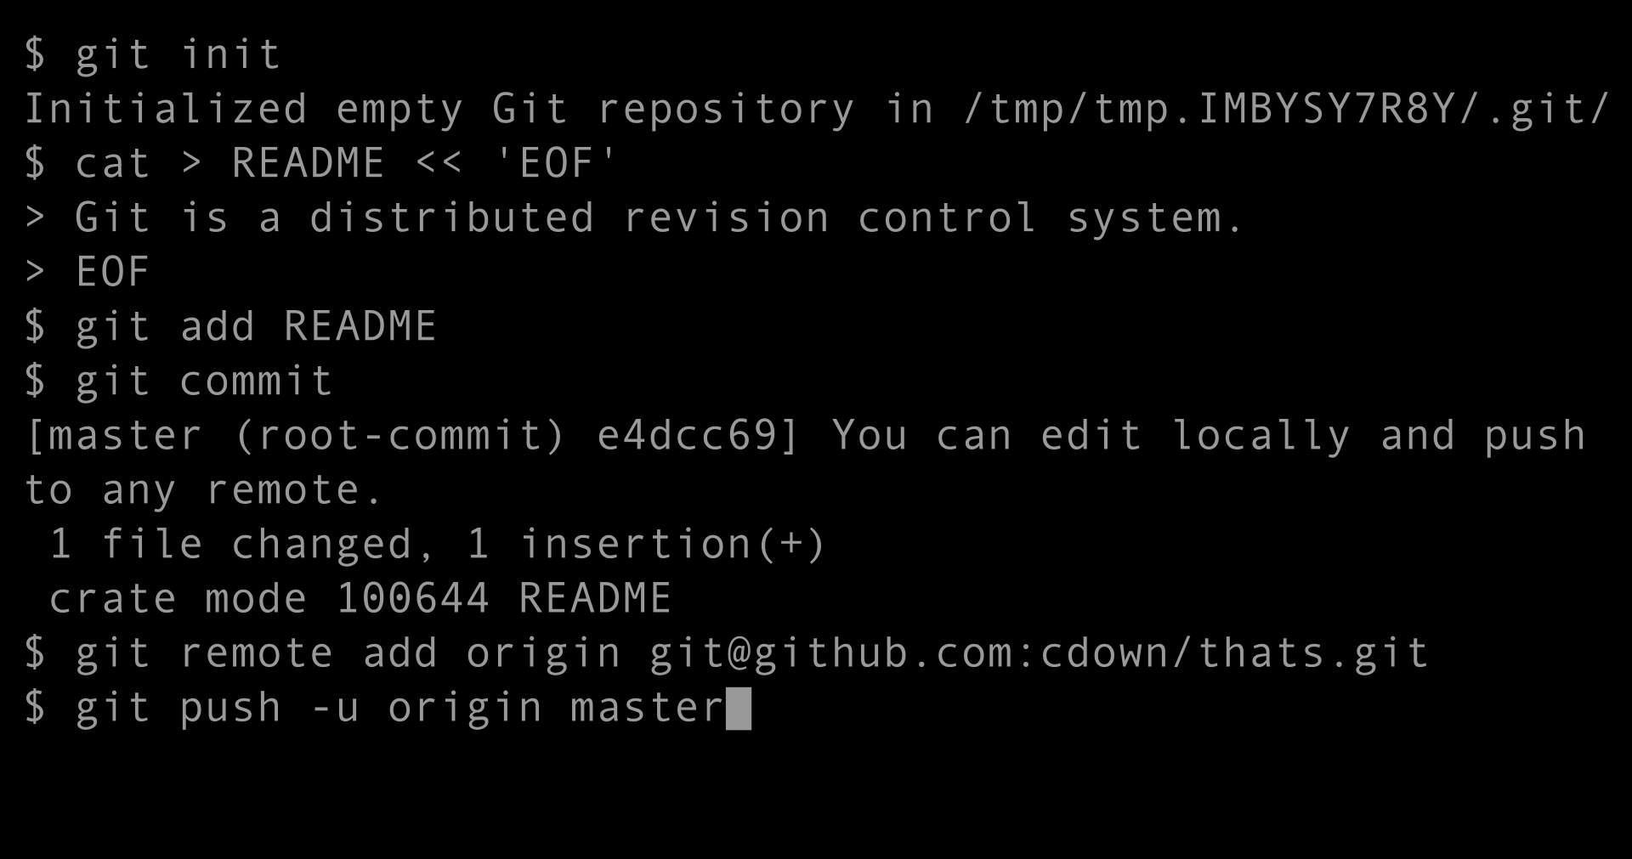





Various Tools to Git it Done
Git Clients
Repository Services

Slide 5

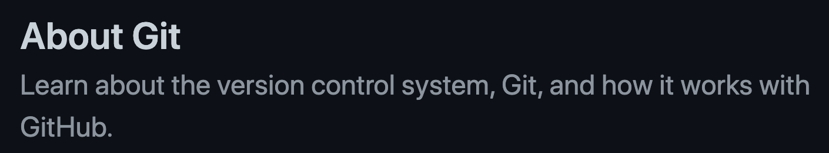

Learning Resources
https://docs.github.com/en/get-started/using-git/about-git
https://skills.github.com/

Slide 6
First Day on GitHub
What is GitHub?
Hey, it's your first time here, so let's not take any chances. Check out this short video to understand why people use GitHub.
Introduction to GitHub
That video is pretty cool, right? If you want to learn how to use the workflow described in that video, take this course.
Git Handbook
By now you are probably wondering what a Git is and why it is important in writing code. We have you covered with this short article on version control with Git.
Communicating using Markdown
Uploading your project to GitHub
GitHub is all about collaboration and we collaborate in issues in pull requests. Learn how to get your point across with the worlds easiest text formatting syntax.
Now that you know what GitHub does, I bet you're ready to move all of those projects off your local machine. This course will show you how.
Link: https://skills.github.com/#first-day-on-github

Slide 7

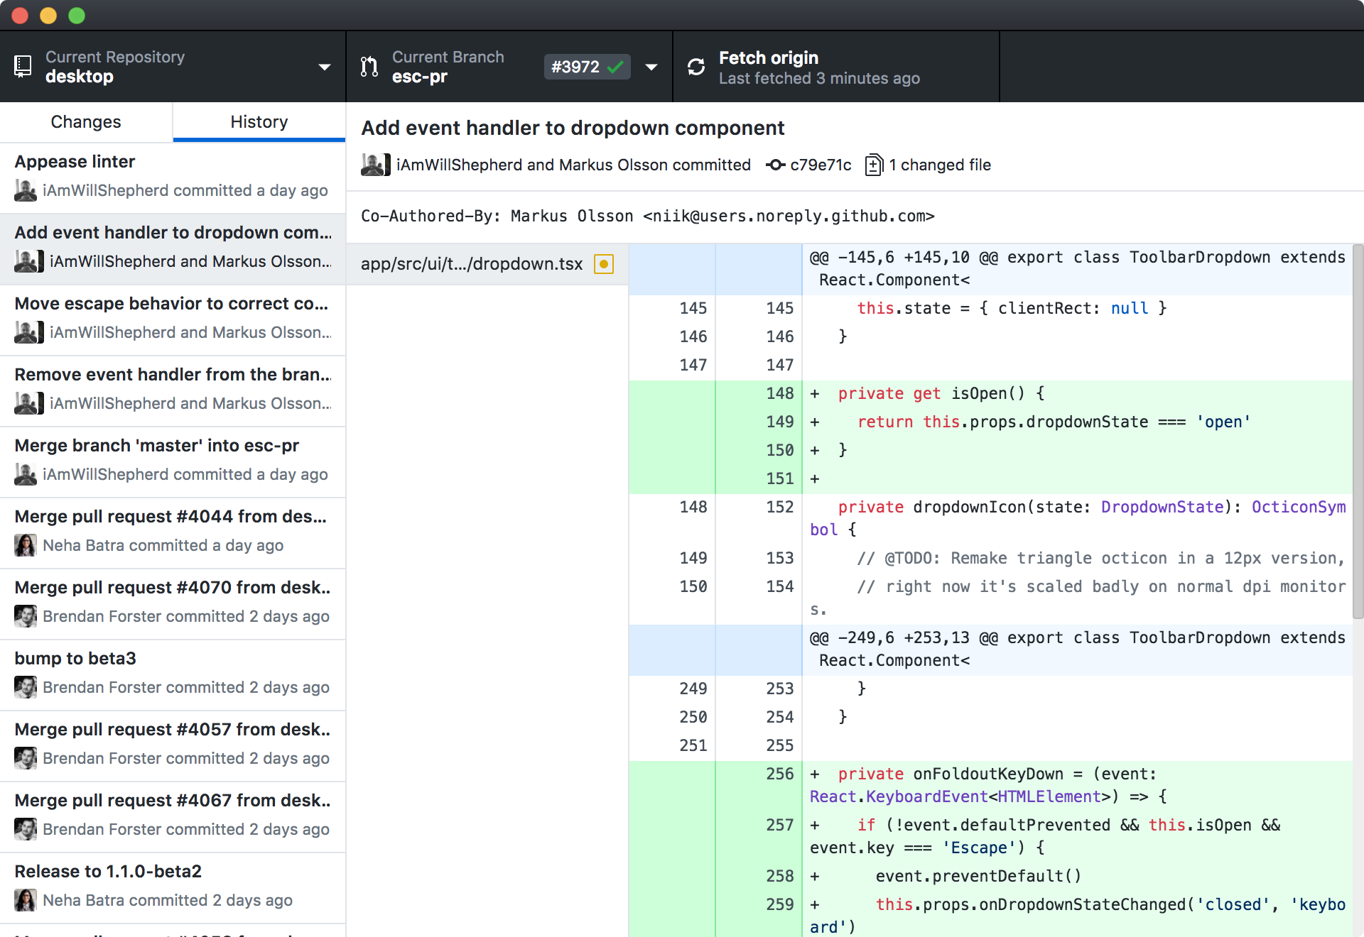
Install GitHub Desktop
GitHub Desktop is a GUI wrapper for Git on your local machine. It makes the Git workflow much easier and allows for visual review of code before committing.
“Focus on what matters instead of fighting with Git. Whether you're new to Git or a seasoned user, GitHub Desktop simplifies your development workflow.”
https://desktop.github.com/

